Slide 1
MIS 321
MVC

Slide 2
MVC
MVC – Model View Controller
Many people jump into learning MVC before looking at the underlying patterns
In fact, MVC, is the king of compound patterns. Understanding the underlying patterns should make learning MVC easier

Slide 3
Example
Let’s start with an example. Let’s say you are using iTunes. You add new songs, manage playlists, rename tracks etc.
The player maintains the database of all your songs and associated data.
The player also plays the songs, updating the interface with the current song, running time, etc.
This can all be managed with the MVC pattern.

Slide 4
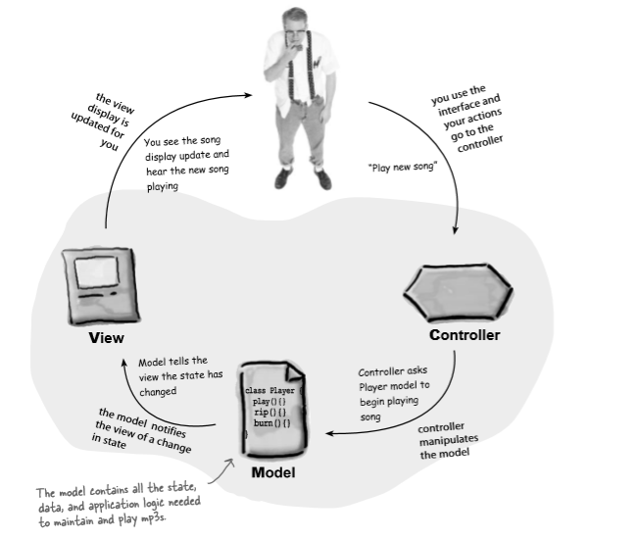
Example
©”Headfirst Design Patters” Freeman, Freeman, Sierra and Bates

Slide 5
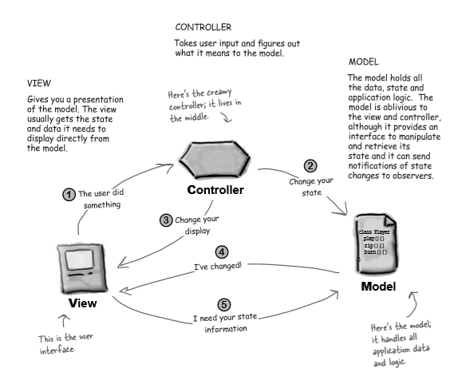
A Closer Look
©”Headfirst Design Patters” Freeman, Freeman, Sierra and Bates

Slide 6
Responsibilities
User – Interact with the view
View is your window to the model. You do things in the view, like click buttons. The view tells the controller what you did. The controller handles it from there.
Controller – Asks the model to change its state
The controller interprets your actions and determines how the model should be manipulated based on that action.
Controller – Also asks the view to change
When the controller gets an action from the view, it may need to tell the view to change as a result.

Slide 7
Responsibilities
Model – notifies the view when its state has changed.
Could be as a result of actions you took, or just internal state changes (i.e. next song started playing)
View – Asks the model for state
The view gets the state directly from the model. For example, when the model notifies a new song started playing, the view might ask for the song name and artist to display. The view might also ask the model as a result of the controller requesting some change in view.

Slide 8
A Pattern of Patterns
It can feel very confusing, but remember to see MVC for what it is: a collection of patterns working together to form the design.
For example:
The model uses observer to keep the views and controllers updated on the latest state changes
The view and controller implement the strategy pattern. The controller is the behavior of the view and can be exchanged with another controller when you want different behavior.
The view uses a pattern we didn’t spend time on this semester called composite to manage windows, buttons, etc.

Slide 9
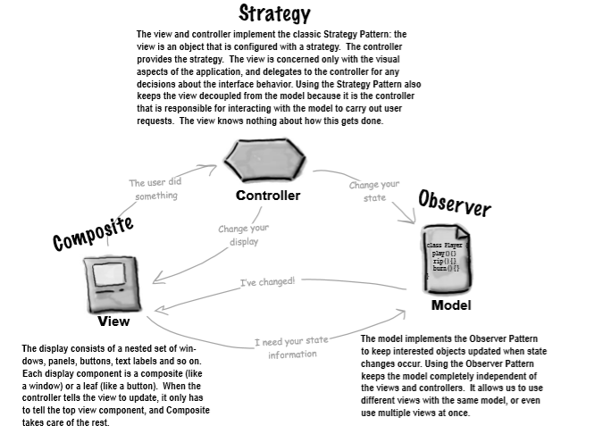
A Pattern of Patterns
©”Headfirst Design Patters” Freeman, Freeman, Sierra and Bates

